Slide 1
System Design and Architecture
--- Detailed Design ---

Slide 2
Analytics part of the system which the notification flow may use
Notification System Design
LB
When using this design, we should note that each unit is defined by its responsibility and also each application part is delimited by Kafka. Using Kafka allows us to scale the system and deal with a massive amount of notifications.
Bulk Notification UI
Bulk Notification Service
Query Engine
ES/Mongo Cluster
Fraud Detection Search Platform Rule Engine
User Transaction Data Parser
Massive amount of data, unstructured, text searches – so elastic or document based DB is applicable
Using the service in order to discover user characteristics and bulk notification sending
We need Kafka in order to have multiple consumers handling the request
Using Kafka in order not to block the user
There is a topic for each priority
LB
KAFKA
KAFKA
KAFKA
Client 2
Notification Validator and Prioritizer
Handlers (SMS/EMAIL/APP) can be horizontally scaled as consumer group
Firebase, Pusher
Provider
Notification Service
Rate Limiter
Notification Handler & User preferences
Email Vendor
SMS Vendor 1
Client 1
Validate notification data integrity
SMS Vendor 2
Redis
User Service
This component doesn’t contain much logic, its responsibility is to receive a message from the client and transfer it to the next layer for processing. LB is use in order to serve a mass users from all over the world.
Analytics on user actions. We may use many topics for each type of data.
Some users want to receive notifications by email only and for certain subjects only we also need to get target user email/phone
User Transaction Data Services (Orders/Searches)
Preferences DB (MySQL)
Not many write operations and many relations in the data structure, so a relational DB is applicable

Slide 3
WhatsApp System Design
Cassandra
We should use Cassandra in order to scale writes!
NFR: Low latency, high availability, lag free, scale!
FR: Message state notifications, group messaging, last seen, asset upload.
Last Seen Service
User DB MySQL
Race: U1 tries to send a message to U3 which is currently offline. Session manager says there is no connected U3 user so the message was not delivered to him. Meanwhile U3 gets connected and fetch all the messages from message service, he gets nothing because U1 message hasn’t been stored yet! After that fetch trial, U1 message gets written to Cassandra. So U3 missed U1 message!
User Service
Redis
Each machine can have 64K ports, so 64K users can be connected to a single WS server. We can scale on higher demand.
The cache stores the users currently connected to the server and other users in other servers we’ve interacted with. The cache expires in seconds!
Group Service
Groups DB MySQL
Group DB, contains the user group assignments
For each user in the group, we fetch his current WS server and send the message to the server
Group Message Handler
When user wants to send message to another user.
LB
WebSocket Server 1
LB
KAFKA
Cache
Which user is connected to which server
Two maps here: Server -> Users User -> Server
U1:U2:M2
User 1
Group messages are handled by Kafka in because we don’t want to overload WS server with this kind of job. WS server is simple server implementation. Note that the group messages are also stored in the DB, in order to allow disconnected users to fetch them later.
User 2
WebSocket Server 2
Session Manager
Redis
User 3
WebSocket Server 3
Message Service
Cassandra
When the user becomes online, it asks for any messages for him. We should also poll the server once in a while in order to avoid race conditions. We should do it in a bulk for all the connected users.
Asset Service
The WS server talks to the session manager to discover the target user and also talks to the message service to store the message or get its state
We have a lot of write volume in the system so we use Cassandra that supports multi writes. The message services store the message and attach it an ID. A message contains also its state: Read, Received etc...
S3
CDN
In order to support media upload we first upload the media then sending the link to the target user as regular message. We don’t upload every image and can detect already uploaded image by using a hash that is computed at the client side

Slide 4
Change user type from active to inactive
Twitter System Design
Get user by ID, Mail etc Also offers bulk API
NFR: Read heavy, fast rendering, fast tweet, scale.
The user timeline should be displayed fast when accessing the home page. Millions of tweets per day.
FR: Tweet, re-tweet, follow, search
We should classify the users upon their number of their followers. We handle these users’ tweets differently. User classification: Famous, Active, Live, Passive, Inactive.
Whenever we design an heavy read system – we should consider to pre-compute information and caching.
LB
KAFKA
User Login/OnBoarding
User Service
User DB MySQL
Redis
User Follow
Graph Service
User DB MySQL
UserID/FollowerID/TimeStamp
User App/Website
Analytics
User Live WebSocket
User became offline
This database doesn’t get updated frequently but contains a lot of data so we should consider sharding
We track the user status in order to see if it live or not. Remember we need to classify users in order to handle a large scale of users
TweetID from UserID
When a user requests his timeline, and he follows a famous user, we need to query that famous tweets from the tweet service – this is because updating the users timeline when a famous user tweets is very expensive!
We can easily check if the user follows a famous user because the timeline service uses the graph service.
We can store the timestamp for this kind of processing in Redis in order not to perform this computation again!
LB
User App/Website
User App/Website
Tweet Ingestion Service
Cassandra/HBase
KAFKA
Query FAMOUS users tweets to be merged with timeline
Query timeline for PASSIVE users
User Live WebSocket
Tweet Service
User Timeline
Timeline Service
Store passive users timeline
Store famous user tweets
For LIVE users, we put an event in Kafka to be handled by User Live Service
LB
Query timeline for active users
U1: T3,T2,T1, TS
U2: T2,T1
U3: T1
Home Timeline
For ACTIVE users only who follows a tweeter (which isn’t famous) we use pre-computation – we put in Redis, which stores the timeline for these users, the new tweet. We apply this route for active users only because if we would do it for all user the machine RAM won’t suffice
Redis
Tweet Processor
User Service
Graph Service
For FAMOUS user who follows a FAMOUS user, we can update the Redis time line

Slide 5
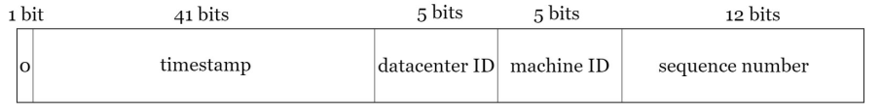
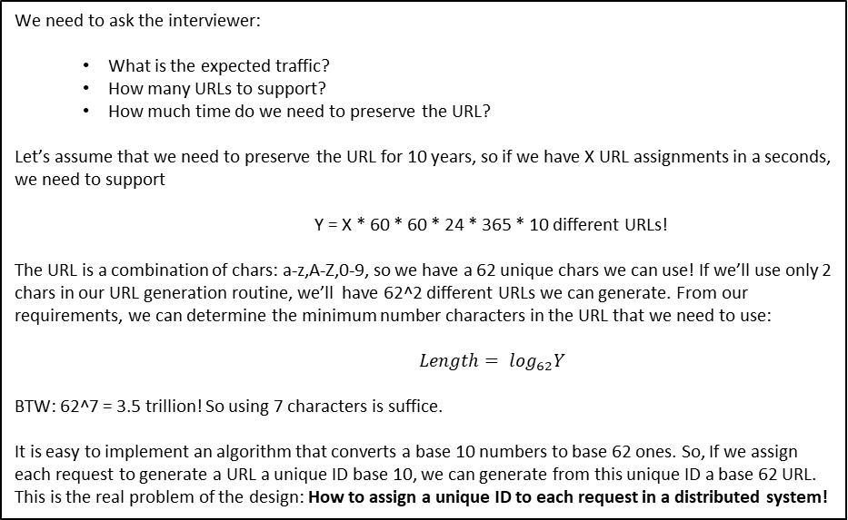
Tiny URL System Design
We need to ask the interviewer:
What is the expected traffic?
How many URLs to support?
How much time do we need to preserve the URL?
Let’s assume that we need to preserve the URL for 10 years, so if we have X URL assignments in a seconds, we need to support
Y = X * 60 * 60 * 24 * 365 * 10 different URLs!
The URL is a combination of chars: a-z,A-Z,0-9, so we have a 62 unique chars we can use! If we’ll use only 2 chars in our URL generation routine, we’ll have 62^2 different URLs we can generate. From our requirements, we can determine the minimum number characters in the URL that we need to use:
${Length= log}_{62}Y$
BTW: 62^7 = 3.5 trillion! So using 7 characters is suffice.
It is easy to implement an algorithm that converts a base 10 numbers to base 62 ones. So, If we assign each request to generate a URL a unique ID base 10, we can generate from this unique ID a base 62 URL. This is the real problem of the design: How to assign a unique ID to each request in a distributed system!
How to assign a unique ID to each request in a distributed system?
Flicker uses a Ticket Server which is a centralized auto_increment feature in a single database server. The problem with this approach is that the server is a Single point of failure. Single ticket server means if the ticket server goes down, all systems that depend on it will face issues. The solve the SPOF issue Flicker uses two ticket servers and divides responsibility between the two servers by dividing the ID space down the middle to evens and odds ID generation. (https://code.flickr.net/2010/02/08/ticket-servers-distributed-unique-primary-keys-on-the-cheap)
Twitter snowflake ID generator which generates a number using these scheme: Datacenter IDs and machine IDs are chosen at the startup time, generally fixed once the system is up running. Any changes in datacenter IDs and machine IDs require careful review since an accidental change in those values can lead to ID conflicts. Timestamp and sequence numbers are generated when the ID generator is running.
The guy at CodeKarle suggests to use a token service that is in charge to provide a range of base 10 numbers to each short URL service machine. The machines will use that range to assign an incoming generate request with an ID that will get converted to base 62. The token service will run on a single-threaded model and cater to only one machine at a time so that each machine has a different range. Our services will only interact with this token service on startup and when they are about to run out of their range, so token service can be something simple like a MySQL service as it will be dealing with a very minimal load. We will of course make sure that this MySQL service is distributed across geographies to reduce latency and also to make sure it is not a single point of failure.
Take a number in the range, convert it to base 62, write to Cassandra and return to the caller
Cassandra
LB
200,001 – 300,000
Range
Increasing the length of our range. That would mean that machines will approach the token service at a much lower frequency.
Short URL Service
Long to Short UI
Short URL Service
Token Service
MySQL
100,001 – 200,000 Range
Very low traffic, so it is single threaded and is not scaled but has a backup machines

Slide 6
DNS are slow and this is the reason we cache them
Web Crawler Design
We can store the content as a file under Hadoop cluster (HDFS)
DNS Cache
Internet
Content Storage
Seed URLs
URL Frontier
Fetcher + Renderer
Content Parser
Content Storage Cache - Redis
URL
To crawl the entire web, we need to be creative in selecting seed URLs. A good seed URL serves as a good starting point that a crawler can utilize to traverse as many links as possible.
Each machine contains many threads but each thread handles a single domain. When a thread is free it asks the frontier for URL
Using hash algorithms to check
If page content has been changed. Special hash algorithms, like minhash, are designed to detect how massive the change was
Link Extractor
Image Extractor
... Extractor
URL Filter
Blacklisted URLs are filtered here link to files are also filtered
URL Loader
Can use Bloom Filter to detect if URL has been seen
The URL frontier is an important component to ensure politeness, URL prioritization, and freshness:
Politeness - Generally, a web crawler should avoid sending too many requests to the same hosting server within a short period. The general idea of enforcing politeness is to download one page at a time from the same host. A delay create by the download thread can be added between two download tasks, so the politeness constraint is implemented by maintain a mapping from website hostnames to download (worker) threads. Each download thread has a separate FIFO queue and only downloads URLs obtained from that queue to ensure the delay.
Priority - We prioritize URLs based on usefulness, which can be measured by PageRank [10], website traffic, update frequency. The Prioritizer uses many queues where each has an assigned priority. Queues with high priority are selected with higher probability.
When examine URLs we need to sort query params to avoid same URLs but different params order
URL Storage
1
B1
The total number of threads should
be equal to the number of back queues
Prioritizer
2
Queue Router
B2
Queue Selector
Fetcher & Renderer Threads
N
BN
When a fetcher is free, it asks for a URL form the selector
Queue ID | Host
b1 | Wikipedia
b2 | Apple.com
In case the thread’s linked queue is empty we can instruct the Queue selector to update its mapping and assign a new host to be handled by the queue

Slide 7
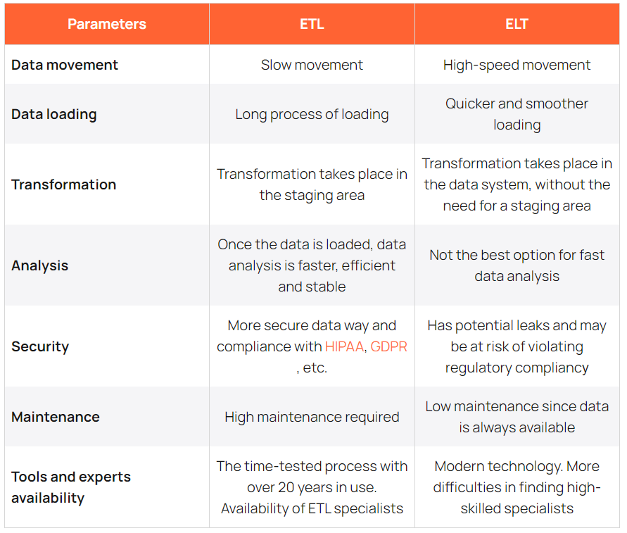
ETL vs ELT
The main conceptual difference is the final step of the process: in ETL, clean data is loaded in the target destination store. In ELT, loading data happens before transformations - the final step is transforming the data just before data analysis.
In the Extract Load Transform (ELT) process, you first extract the data, and then you immediately move it into a centralized data repository. After that, data is transformed as needed for downstream use. This method gets data in front of analysts much faster than ETL while simultaneously simplifying the architecture.
ETL Technologies:
The Amazon S3 Sink Connector exports data from Apache Kafka topics to S3 objects in either Avro, JSON, or Bytes formats.
Once in S3 we can use Using the Parquet format in AWS Glue. AWS Glue retrieves data from sources and writes data to targets stored and transported in various data formats.
Times series in ETL: The two most popular time-series databases are InfluxDB and Prometheus, which are designed to store large volumes of time-series data and quickly perform real-time analysis on that data.
Column-oriented databases are better suited to OLAP scenarios: they are at least 100 times faster in processing most queries this is because the system avoids reading unnecessary columns to avoid expensive disk read operations. Also, Storing different values of the same column together often leads to better compression ratios (compared to row-oriented systems) because in real data a column often has the same, or not so many different, values for neighboring rows. Reading data from parquet can be done using ClickHouse.
Bigtable also excels as a storage engine for batch MapReduce operations, stream processing/analytics, and machine-learning applications. A Bigtable table is sharded into blocks of contiguous rows, called tablets, to help balance the workload of queries. (Tablets are similar to HBase regions.) Tablets are stored on Colossus, Google's file system, in SSTable format. An SSTable provides a persistent, ordered immutable map from keys to values, where both keys and values are arbitrary byte strings. Each tablet is associated with a specific Bigtable node. In addition to the SSTable files, all writes are stored in Colossus's shared log as soon as they are acknowledged by Bigtable, providing increased durability.

Slide 8
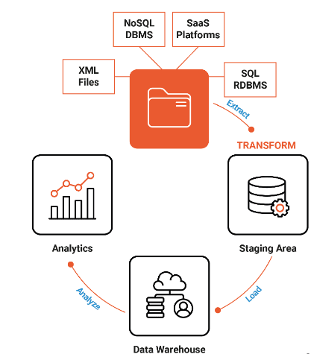
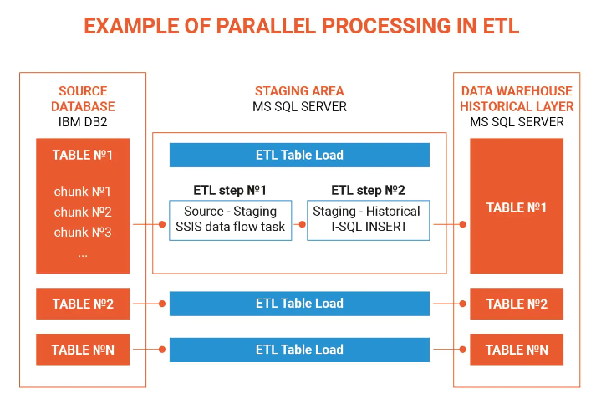
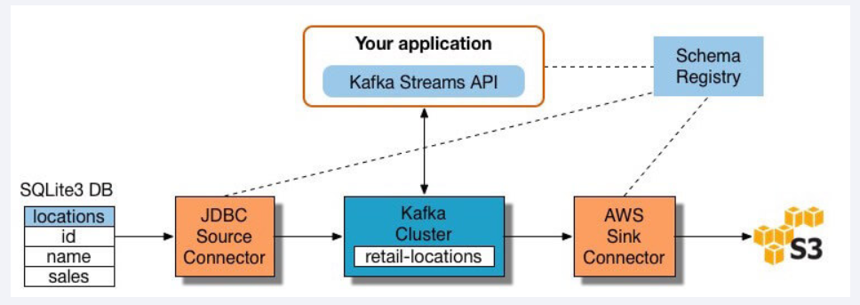
ETL With Streaming
Extract data into Kafka: the connector pulls each row of the source table and writes it as a key/value pair into a Kafka topic. Applications interested in the state of this table read from this topic. As client applications add rows to the source table, Kafka automatically writes them as new messages to the Kafka topic, enabling a real-time data stream
Pull data from Kafka topics: the ETL application extracts messages from the Kafka topic.
Transform data in KStream objects: with the Kafka Streams API, the stream processor receives one record at a time, processes it, and produces one or more output records for downstream processors. These processors can transform messages one at a time, filter them based on conditions, and perform data operations on multiple messages such as aggregation.
Load data to other systems: the ETL application still holds the enriched data, and now needs to stream it into target systems, such as a data warehouse or data lake. We can use S3 Sink Connector to stream the data to Amazon S3. We can also integrate with other systems such as a Redshift data warehouse using Amazon Kinesis.

Slide 9
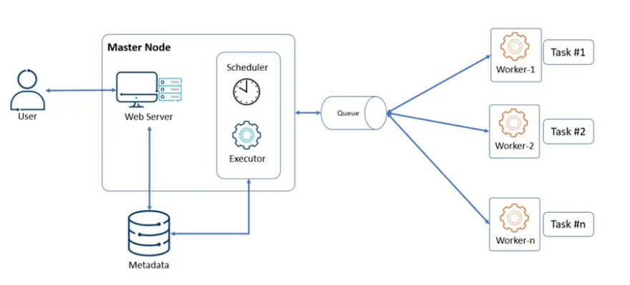
Airflow – A Task Scheduler Architecture
Scheduler: The scheduler is a critical component of Airflow. Its primary function is to continuously scan the DAGs (Directed Acyclic Graphs) directory to identify and schedule tasks based on their dependencies and specified time intervals. The scheduler is responsible for determining which tasks to execute and when. It interacts with the metadata database to store and retrieve task state and execution information.
Executors:
Airflow supports different executor types to execute tasks. The executor is responsible for allocating resources and running tasks on the specified worker nodes. The two primary executor types in Airflow are:
Sequential Executor: The sequential executor executes tasks sequentially on a single worker node. It is useful for local development and testing scenarios where parallelism is not a requirement.
Distributed Executors: Airflow also supports distributed executors like the Celery Executor and the Kubernetes Executor. These executors distribute task execution across multiple worker nodes or containers, enabling parallel processing of tasks.
Message Queue: Airflow relies on a message queue system, such as RabbitMQ, Apache Kafka, or Redis, to enable communication between the scheduler and the worker nodes. The scheduler places task execution requests in the message queue, and the worker nodes pick up these requests, execute the tasks, and update their status back to the metadata database. The message queue acts as a communication channel, ensuring reliable task distribution and coordination.
Metadata Database: Airflow leverages a metadata database, such as PostgreSQL or MySQL, to store all the configuration details, task states, and execution metadata. The metadata database provides persistence and ensures that Airflow can recover from failures and resume tasks from their last known state. It also serves as a central repository for managing and monitoring task execution.
Web Server: The web server component provides a user interface for interacting with Airflow. It enables users to monitor task execution, view the status of DAGs, and access logs and other operational information. The web server communicates with the metadata database to fetch relevant information and presents it in a user-friendly manner. Users can trigger manual task runs, monitor task progress, and configure Airflow settings through the web server interface.

Slide 10
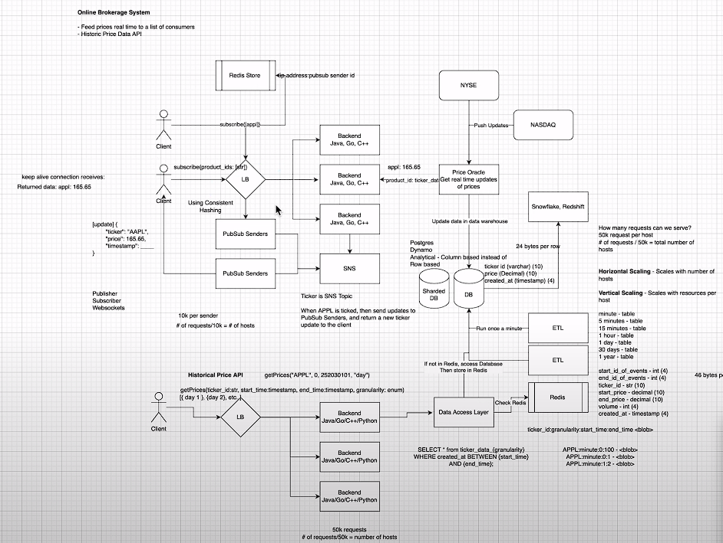
Online Price Feed
The price oracle gets its price quotes by push notifications from external providers. It then feeds the prices to a distributed event streaming platform (SNS/Kafka) where each ticker is used as SNS topic. The price senders receive the prices from the streaming sources. An LB server uses Redis store to track senders, and when a client connects to the BE server in order to subscribe to a ticker, he receives a sender IP and which then connects to it by web sockets.
We also need support for historical data retrieval. We use and ETL upon our DB to insert to a time series DB server the data grouped by granularity (1m, 5m, 10ms and so on). The client then uses a cluster of BE servers used to query that time series DB to retrieve the data. We also use caching in order to cache request where its parameters are the key and a blob containing the price data is the value.
Reference: https://www.youtube.com/watch?v=qo3Cq13aCa4

